Slide 1
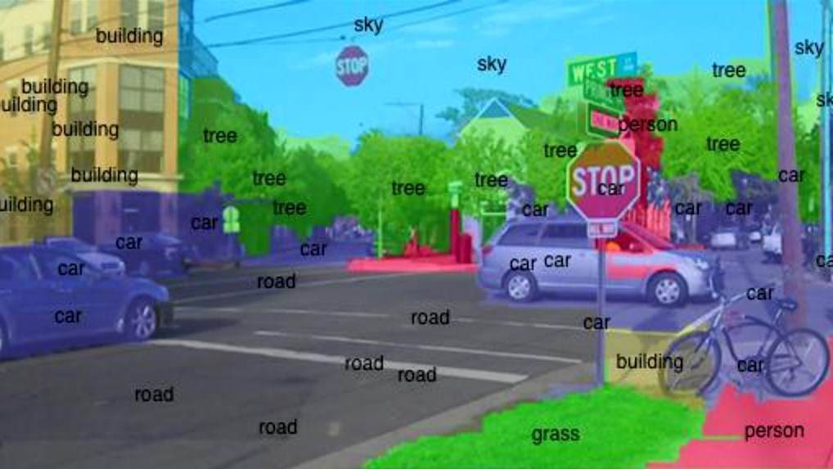
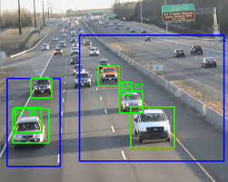
AUB Robotics Club Computer Vision Workshop
Malek Itani – Fall 2020

Slide 2
What is Computer Vision
Allowing a Computer to ‘see’
Receive Input
Image Processing
Image Manipulation
Feature Extraction

Slide 3






Where is it used?
Object Detection, Face Recognition, Self-Driving Cars, Medical Purposes, ...

Slide 4
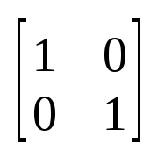
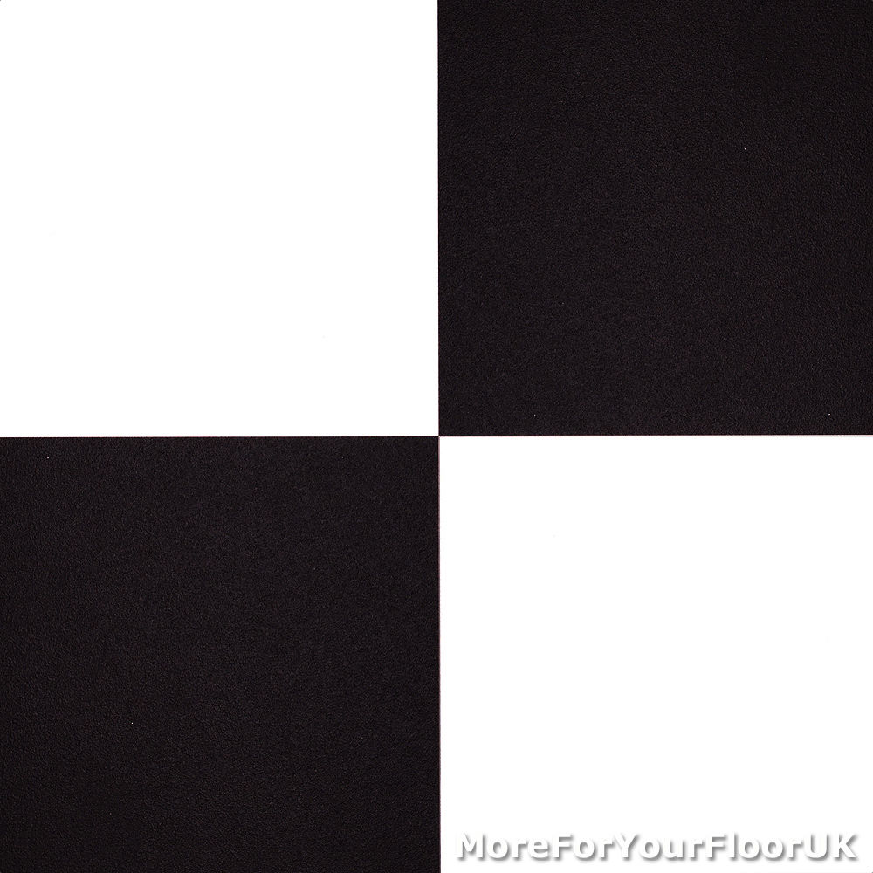
Understanding Computer Vision
Images are treated as matrices
Matrix entries represent pixel values
Grayscale images: 1 value per entry
Color images: 3 values (sometimes 4)
(R,G,B)

Slide 5
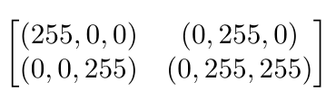
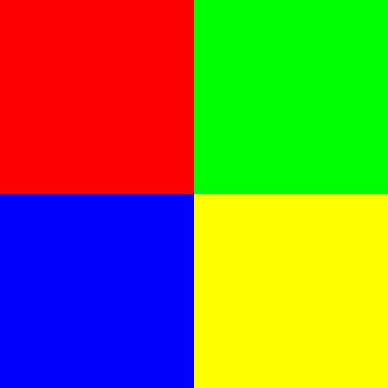
Understanding Computer Vision
Example (RGB)
Images can be displayed using matplotlib’s imshow() method
*** Color images are BGR in OpenCV ****
Powerful representation: All operations are equivalent to mathematical operations

Slide 6
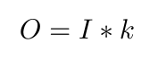
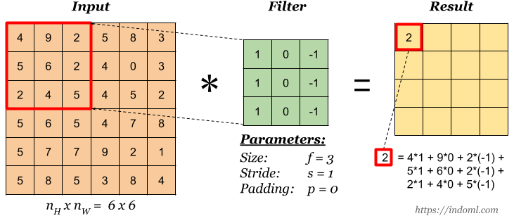
Convolution
A mathematical operation between two matrices
Go over every pixel, assign a new value as a weighted sum of surrounding pixels.
Output Image
Input Image
kernel/ filter

Slide 7
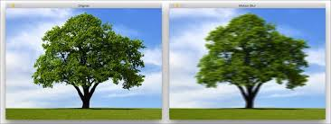
Blurring Images
Quick way to remove noise
Good when details aren’t important
Easier to process images
Intuitive mathematical interpretation: Averaging

Slide 8
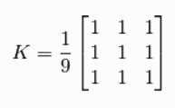
Basic Approach
Take the average of the 3x3 pixels around every pixel in the image

Slide 9

Tool - OpenCV
Computer Vision Library
Has bindings in Python, C++ and Java (Android)
Most commonly used, largest support
Other libraries include: scikit-image, SimpleCV, ...

Slide 10
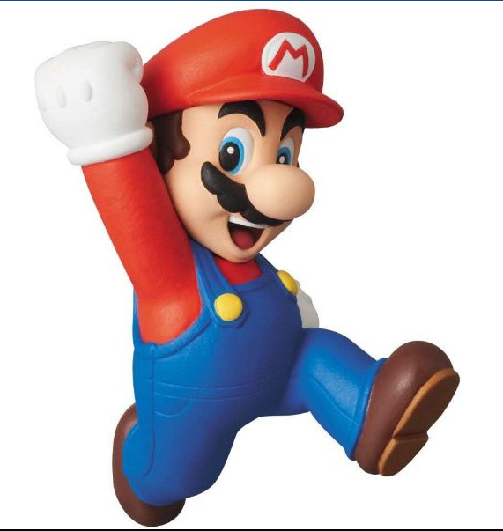
Reading and Displaying Images
Quick detour: Get familiar with OpenCV

Slide 11
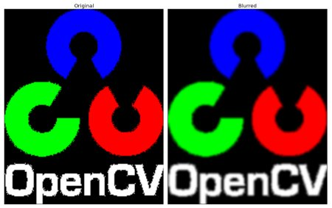
Blurring Images
cv2.GaussianBlur(img, kernel, std_devX)

Slide 12
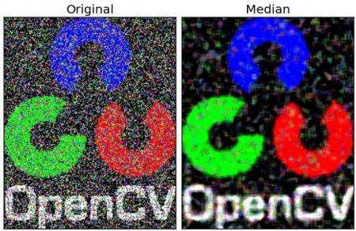
Blurring Images
cv2.medianBlur(img, kernelsize)

Slide 13
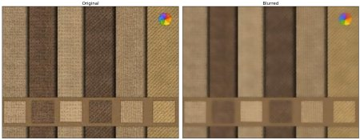
Blurring Images
cv2.bilateralFilter(img,diameter,sigmaColor,sigmaSpace)
math

Slide 14
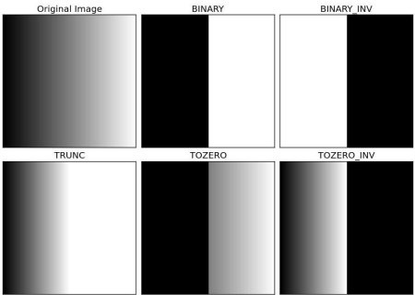
Thresholding
Global:
cv2.threshold(img, lowerlimit, upperlimit, mode)
Modes:
cv2.THRESH_BINARY
cv2.THRESH_BINARY_INV
cv2.THRESH_TRUNC
cv2.THRESH_TOZERO
cv2.THRESH_TOZERO_INV

Slide 15
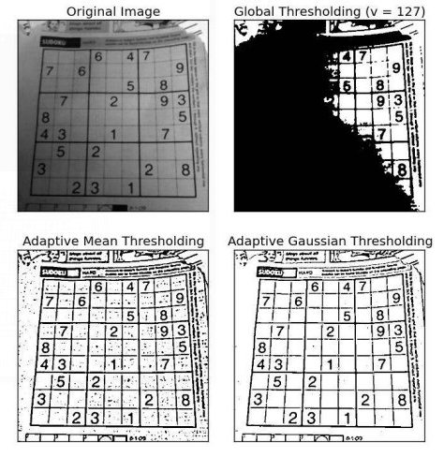
Thresholding
Adaptive:
cv2.adaptiveThreshold(img, upperlimit, method, type, blocksize, c)
Types:
cv2.ADAPTIVE_THRESH_MEAN_C
cv2.ADAPTIVE_THRESH_GAUSSIAN_C

Slide 16
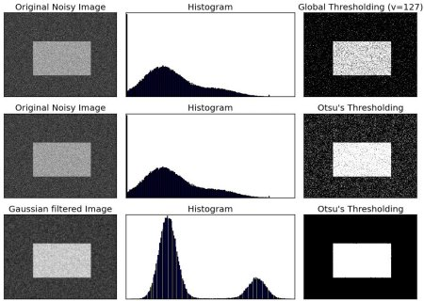
Thresholding++: Otsu
Adaptive:
Great for bimodal images
Finds an optimal threshold value and returns it
cv2.threshold(blur,0,255,cv2.THRESH_BINARY+cv2.THRESH_OTSU)

Slide 17
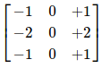
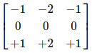
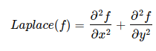
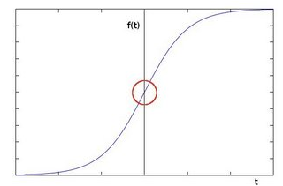
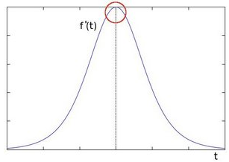
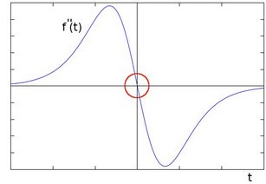
Image Gradients and Edge Detection
Derivative Kernels
Find pixels where laplacian is 0

Slide 18
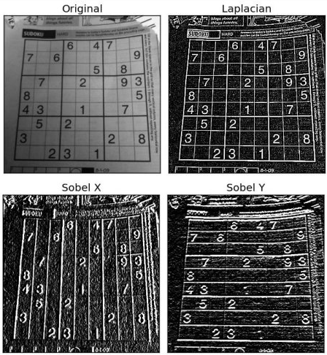
Image Gradients and Edge Detection
cv2.Laplacian(img,cv2.CV_8U)

Slide 19
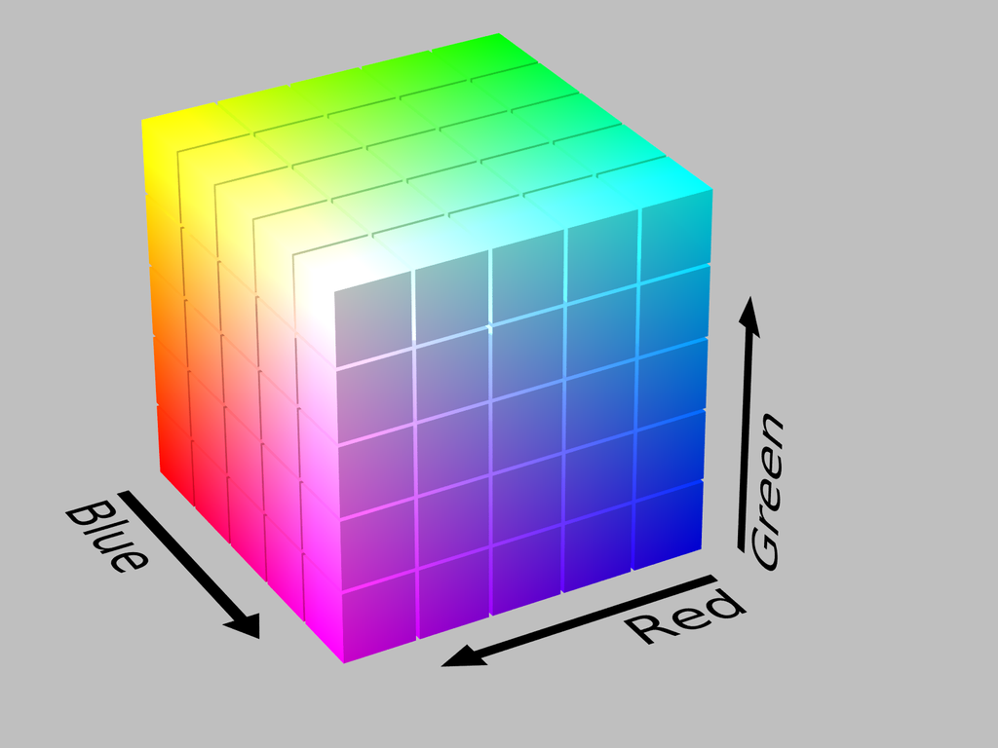

Color Spaces
Different color representations
Color changes are interpreted differently
Think changes in brightness
Examples: BGR, HSV, LAB, LVB, Grayscale, ...

Slide 20
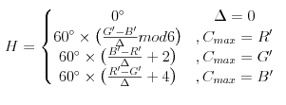
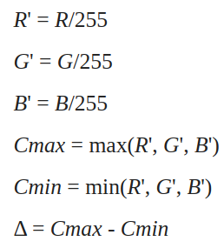
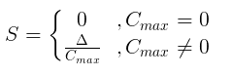
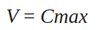
Color Spaces: Conversion Examples
BGR to HSV
BGR to Grayscale

Slide 21
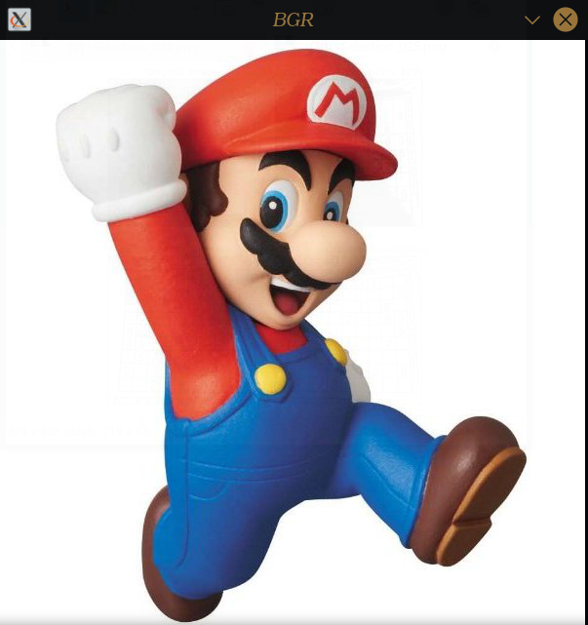
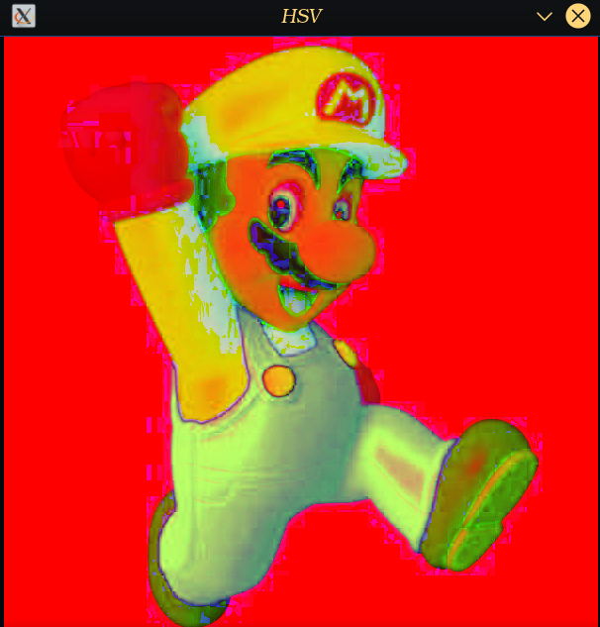
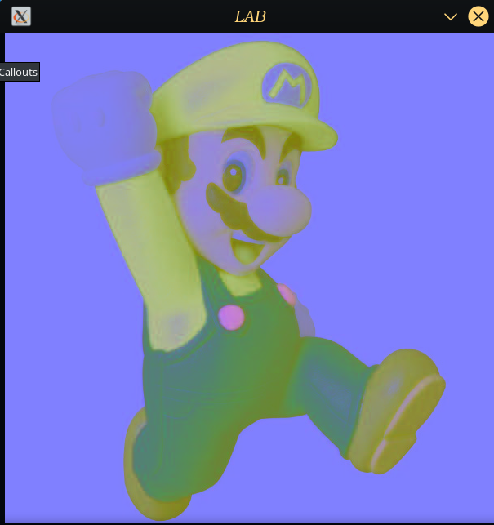
Color Spaces
To convert between color spaces:
use cv2.cvtColor(img, code)
code: cv2.COLOR_BGR2HSV, cv2.COLOR_BGR2LAB, cv2.COLOR_BGR2GRAY, …
cv2.imshow assumes images are in BGR

Slide 22
Channel Splitting & Merging
Splitting an image into its constituent channels
B, G, R = cv2.split(img)
Each resulting image can be blurred, thresholded, …
To merge back, use:
cv2.merge((B, G, R))

Slide 23
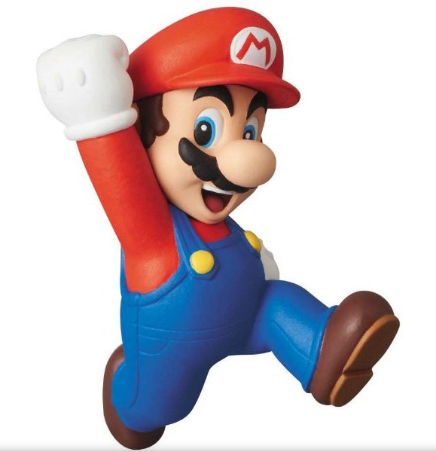
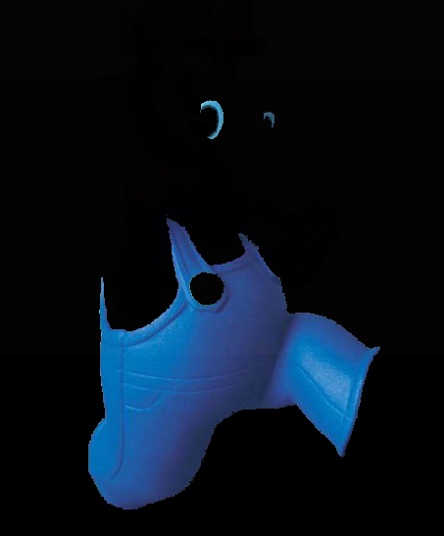
Color Isolation
Obtain a mask:
cv2.inRange(img, lowerRange, upperRange)
Bitwise comprison:
cv2.bitwise_and(img, img, mask)

Slide 24


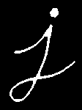
Morphological Operations
Dilation: cv2.dilate(img,kernel,iterations = 1)
Erosion: cv2.erode(img,kernel,iterations = 1)

Slide 25

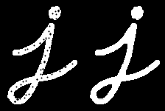
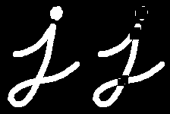
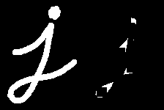
Morphological Operations
Others: Closing, Opening, Top Hat, Black Hat
cv2.MorphologyEx(img, type, kernel)
Closing
Opening
Top Hat
Black
Hat

Slide 26
Finding Contours
Works on Grayscale images
_,contours,hierarchy=cv2.findContours(img,flag, approximationType)
Returns a list of contours, and its hierarchy
cv2.drawContours(img, c, countour #, color, thickness)
Flags: RETR_EXTERNAL, RETR_TREE, RETR_LIST
Approximations: CHAIN_APPROX_SIMPLE/NONE

Slide 27


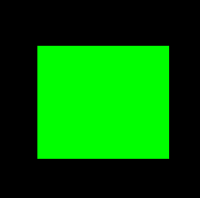
Drawing Shapes
Lines:
cv2.line(img, p1,p2,color,thickness)
Circles:
cv2.circle(img, center, radius, color, thickness)
Rectangles:
cv2.rectangle(img,upperLeft,bottomRight,color,thickness)

Slide 28
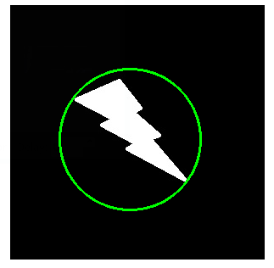
Bounding Shapes
Approximate the shape of a contour with a shape
Useful for object tracking
Minimum Enclosing Circle
(x,y),radius = cv2.minEnclosingCircle(contours)

Slide 29
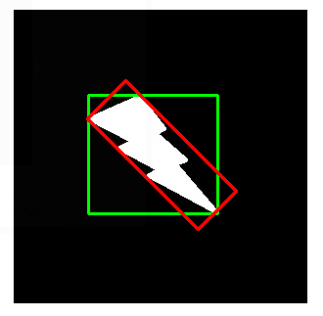
Bounding Shapes
Bounding Rectangle
x,y,w,h = cv2.boundingRect(contours)

Slide 30
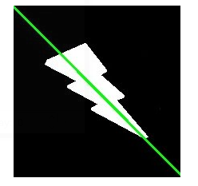
Bounding Shapes
Fitting a Line
[vx,vy,x,y] = cv2.fitLine(cnt, cv2.DIST_L2,0,0.01)

Slide 31
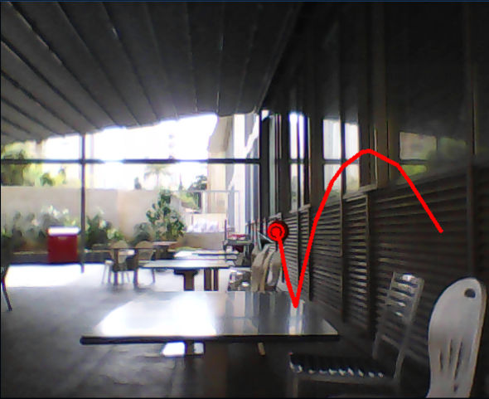
Application: Drawing Trajectories
Read → Process → Isolate → Manipulate
Store centers in a list
Every loop, draw lines connecting consecutive centers

Slide 32
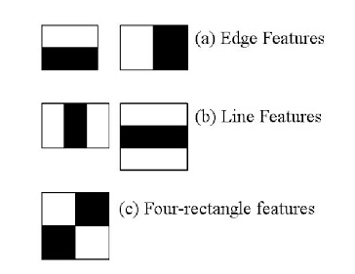
Machine Learning with Computer Vision: Haar-like Features
Teach computers to look for certain features in an image
Positive Images vs Negative Images
Based on a paper published in 2001
Works on grayscale images
Very useful for face recognition

Slide 33
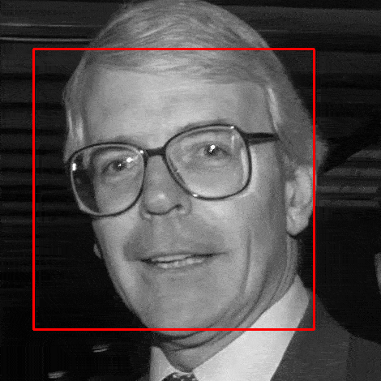
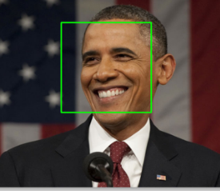
Implementing a Cascade Classifier
Classification data is stored in XML files
face_cascade = cv2.CascadeClassifier(pathToXML)
faces = face_cascade.detectMultiScale(img, weight, numNeighbours)
for (x,y,w,h) in faces:
cv2.rectangle(img,(x,y),(x+w,y+h),(255,0,0),2)

